Slide 1
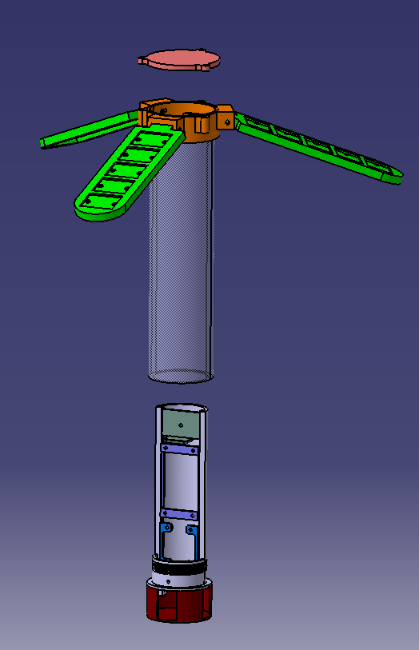
Solar Flap Fixture Screw-on Cap
Solar Flap Fixture
There are prongs under the Solar Flap Fixture Screw-on Cap that will hold an apple air tag
Use threaded inserts for the solar flap to screw on the screw-on cap
There are holes in the Solar Flap Fixture that wires for solar charging can be fed into. Glue/epoxy will need to added to fill in gaps after wires are in.
Solar cells will be epoxied into the solar flap when the charging setup has been tested and verified
Sensor probes will go in first and will fit behind the electrical components (refer to next slide)
Internal components will mount to Battery Tray, PCB Tray, and Sensor Tray. Once these are situated, glue can be used to keep trays from sliding up and down.
Sensor protector cap will be glued on last. (will need to fit grommets and turbidity before gluing it on.
There are holes in the bottom of the component holder that nuts can go into. Push them in until they line up with holes in the side of the component holder
Holes will be drilled into the side of the acrylic tube to line up with the component holder so that screws can be screwed into the nuts that were installed. This is what will keep the component holder from sliding out of the acrylic tube
Most of these components will need to be made out of PVC and not 3D printed for water proofing
Clear coat seems to cause PLA to warp
Epoxy might work, but it is hard to apply evenly and thoroughly
Solar Flap
Acrylic Tube
Battery Tray
PCB Tray
Component Holder
Sensor Tray (TDS, Ph, Turbidity)
Sensor Protector Cap

Slide 2
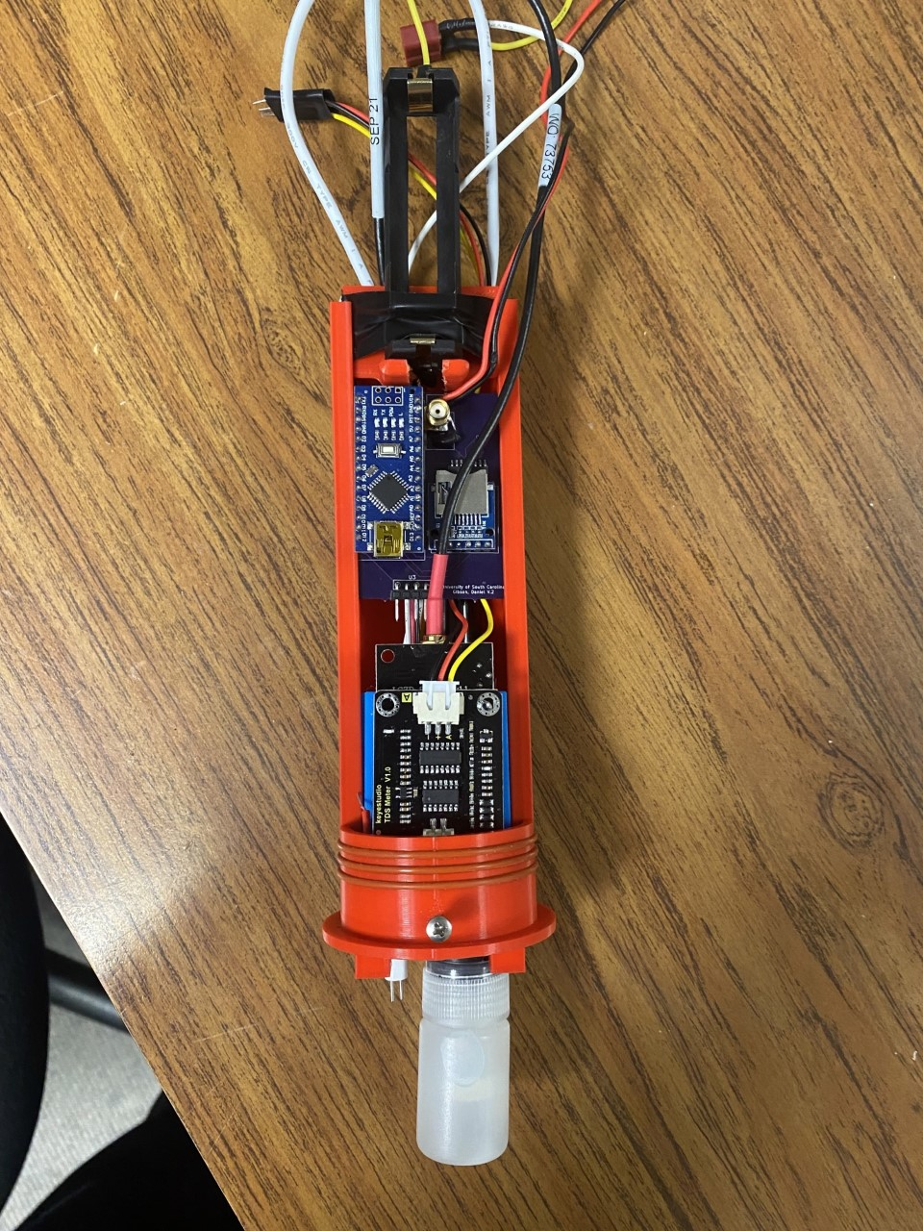
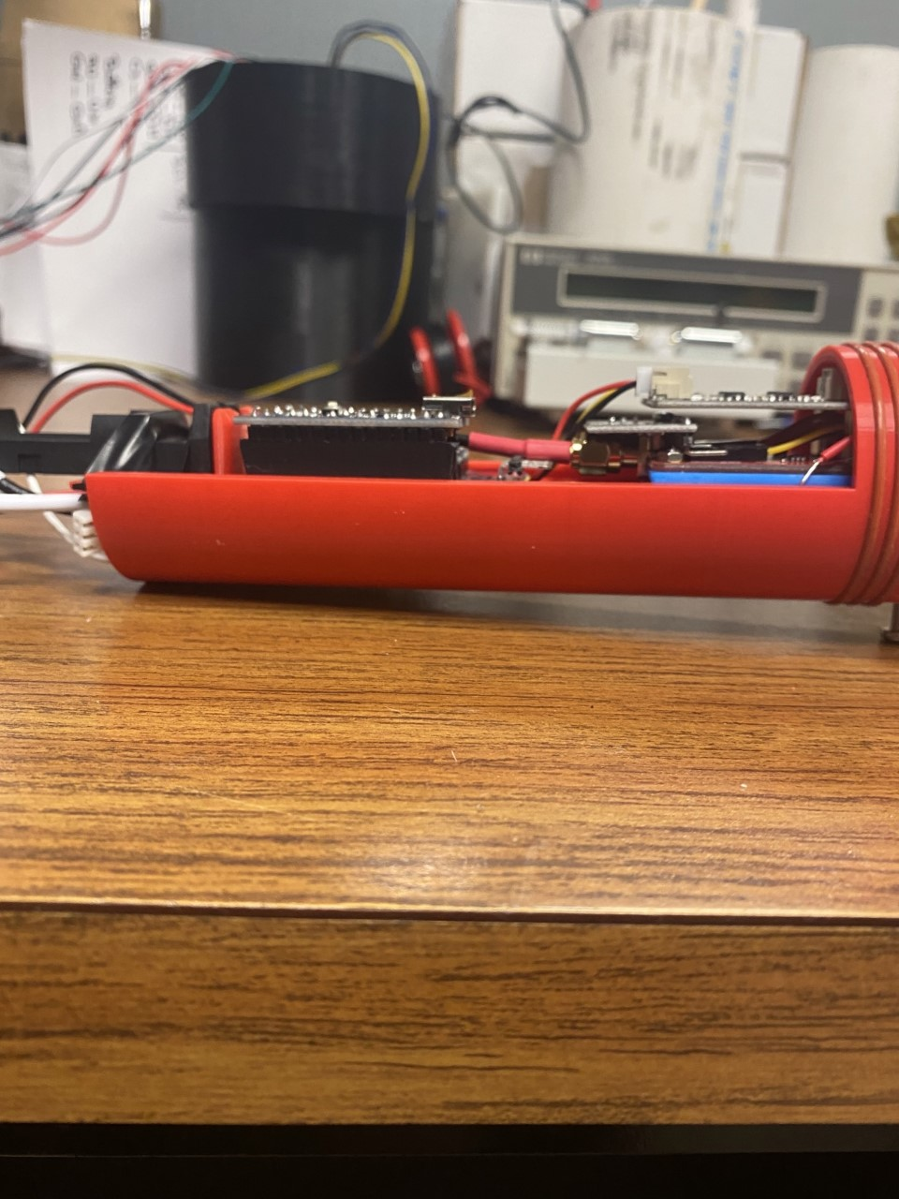
Relevant Pictures

